Slide 1








The STARS Study: Social outcomes in adolescents and young adults (AYA) following a cancer diagnosis
An overview of the quantitative and qualitative findings
Oana Lindner, Richard Mattock & Adam Martin
on behalf of
Dan Stark, Rachel Taylor, Sue Morgan,
Louise Soanes, Angharad Beckett
Sept 2019 – May 2023
Economic and Social Research Council Grant /S00565X/1

Slide 2
Why did we start this research?
Background
~300,000 AYAs (16 to 39yrs) are living with and beyond cancer
Cancer disrupts anybody's personal biography
AYAs should have the same or better opportunities and socio-economic outcomes as their peers or as they would have expected if they were not diagnosed with cancer
Currently unable to undertake prospective research/trials within risk-defined groups
Aim
Define which factors (together or independently) enable or disable AYAs' Social Integration (SI) trajectories, and how

Slide 3
Method
Link methods from oncology, psychosocial oncology, sociology, developmental psychology, health economics to inform medical, psychological, and social care.
  Secondary data
  Quantitative survey and qualitative interview
Co-production: support from our Young Advisory Group.
Describe SI trajectories after cancer diagnosis through:
  Employment (income, type of employment)
  Educational attainment (level of education and training)
  Social development (quantity and quality of social support, connections, and participation)
  Overall quality of life.
Expected results
A description of the range of SI outcomes
Summarise factors contributing to certain SI outcomes in a Multidimensional Stratification Model
Underpin future intervention studies
Integrate the Model within the NHS

Slide 4
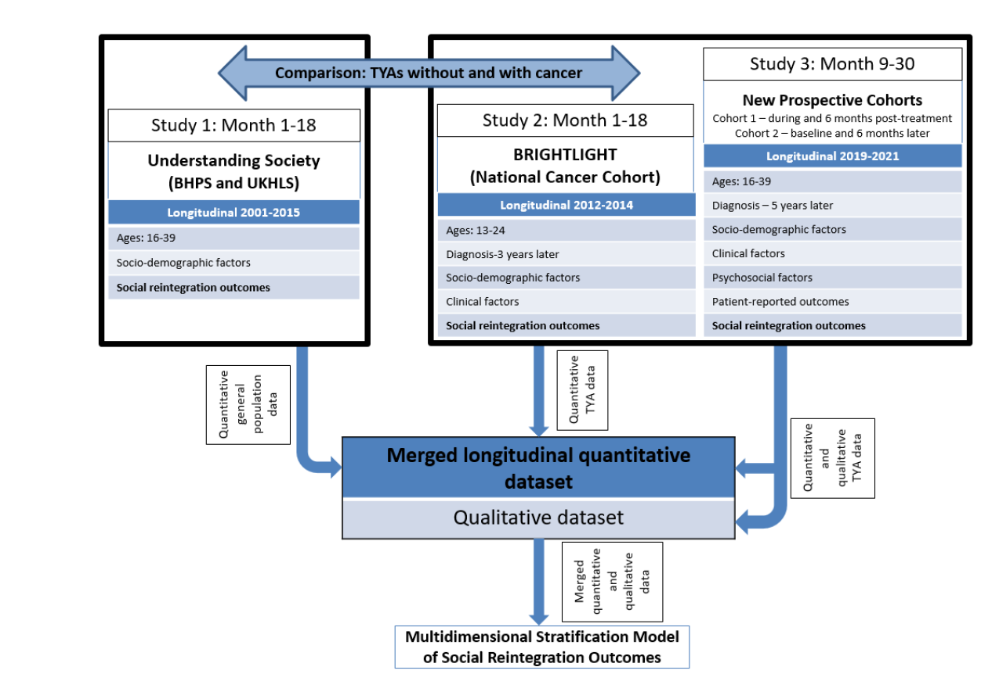
Three interconnected strands

Slide 5
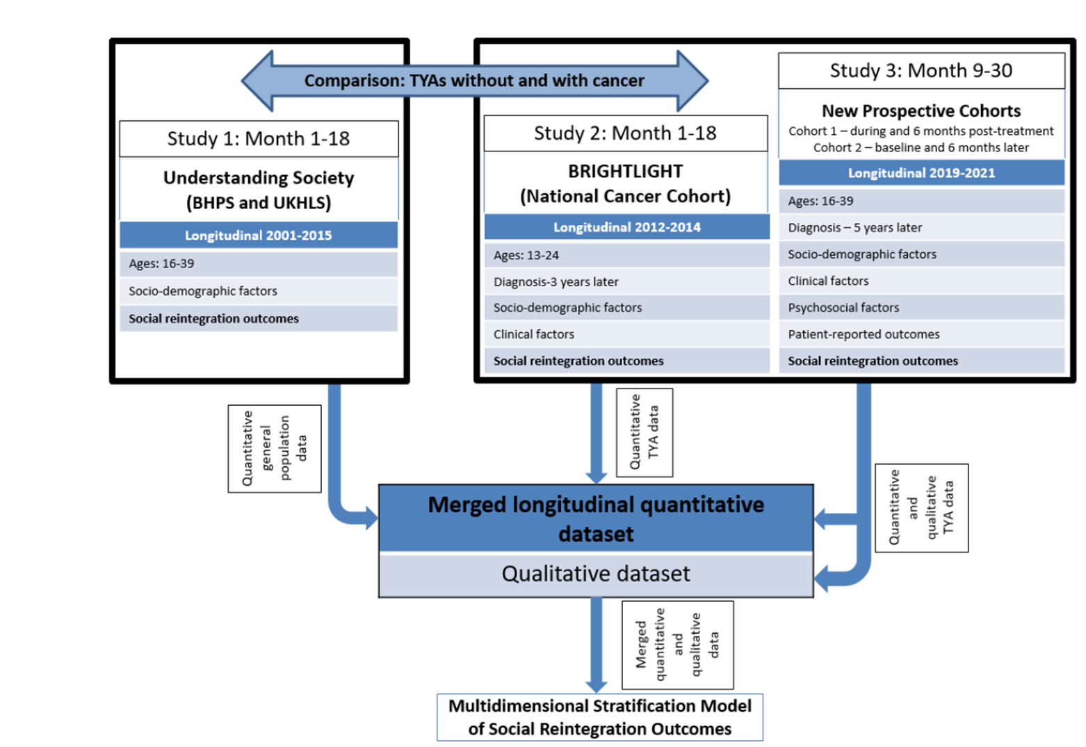

Biographical disruption among adolescents and young adults with chronic disease
Study 1. Summary
Background:
  A seminal 1982 article in which chronic illness was conceptualised as a cause of ‘biographical disruption,’ whereby it can trigger changes in the direction and course of various social and economic aspects of people’s lives
  Other more recent studies have exploited large datasets, but few focus on young adolescents and young adults
  One example is living with a chronic disease
  Policy relevant ☺
Research questions:
  What differences do we observe in various social and economic indicators between AYAs living with a prevalent chronic disease compared to those who have not reported a chronic disease?
  Do these differences vary by gender or by age group (16-24 vs. 25-39)?
Notes:
Social integration begins in childhood but develops and evolves over the whole lifespan. It refers to the attachments people sustain with society, for example through family, education or work.

Slide 6

Method:
  UK Household Longitudinal Study data collected between January 2009 (start of wave 1) and June 2020 (end of wave 10)
  AYAs who were diagnosed with one or more of six chronic diseases (n=9,910) are compared to AYAs who lived without a chronic disease (n=31,795) in terms of seven key indicators of social integration using regression models
  The six chronic diseases were asthma, arthritis, diabetes, epilepsy, high blood pressure and clinical depression
  The seven self-reported economic and social indicators were:
    markers of social support availability (number of friends, online socialising, loneliness)
    markers of social engagement and access to resources (living arrangements, degree-level educational attainment, employment status, and earnings)
Notes:
The UKHLS comprises a representative sample of around 40,000 UK households recruited between January 2009 and June 2011. Questionnaires were completed in annual face-to-face interviews (at home or online) with all household members aged 16 and over.

Slide 7
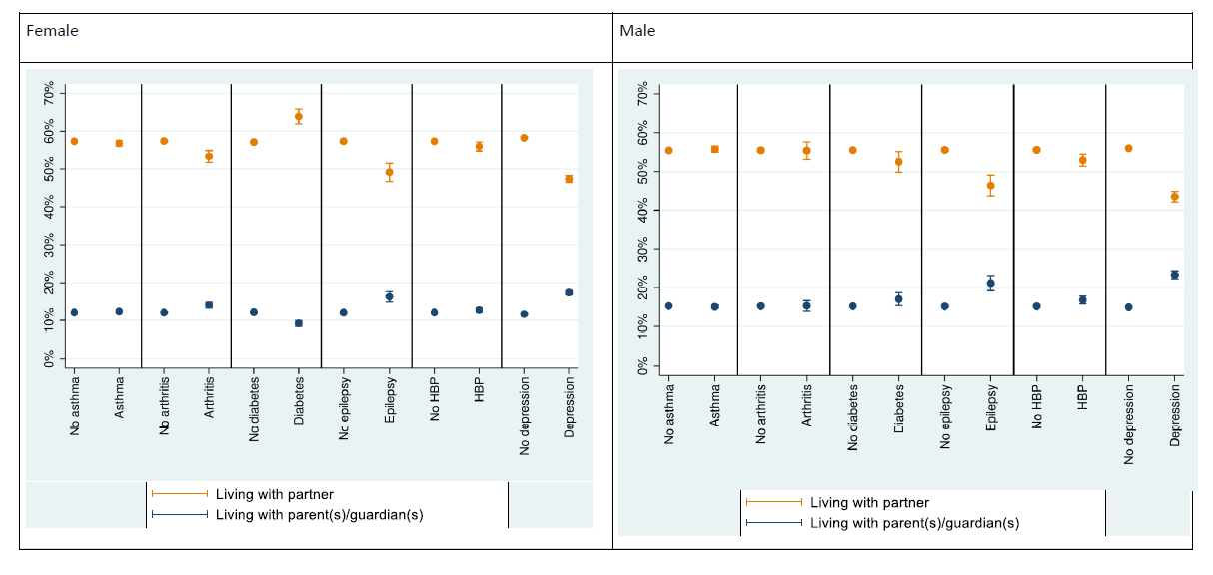
Results:
  Predicted probability of living with parent(s) or guardian(s) and of living alone, by chronic disease and gender

Slide 8
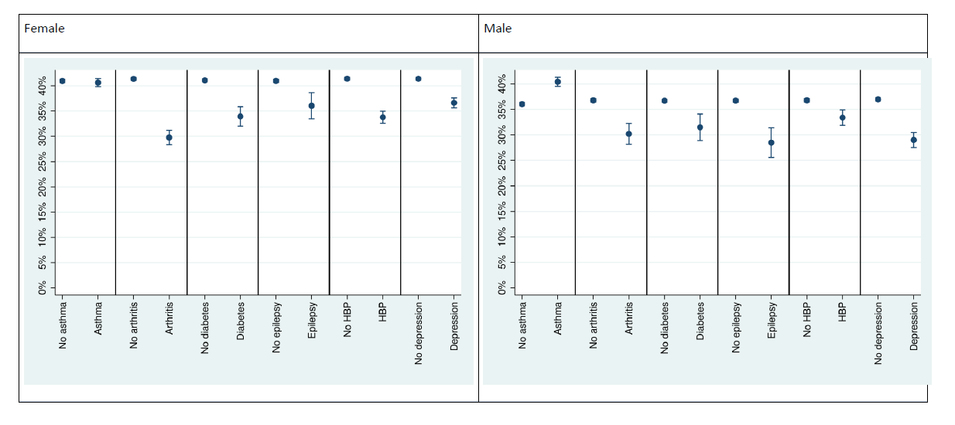
Results:
  Predicted probability of having degree-level educational attainment by chronic disease and gender
Notes:
People living with arthritis, epilepsy, high blood pressure or clinical depression were less likely to be living independently or with a partner, graduates (by 5.0 percentage points) or in work (2.4 percentage points) compared to people without chronic disease. These differences were often similar in magnitude to those observed by gender or ethnicity.

Slide 9
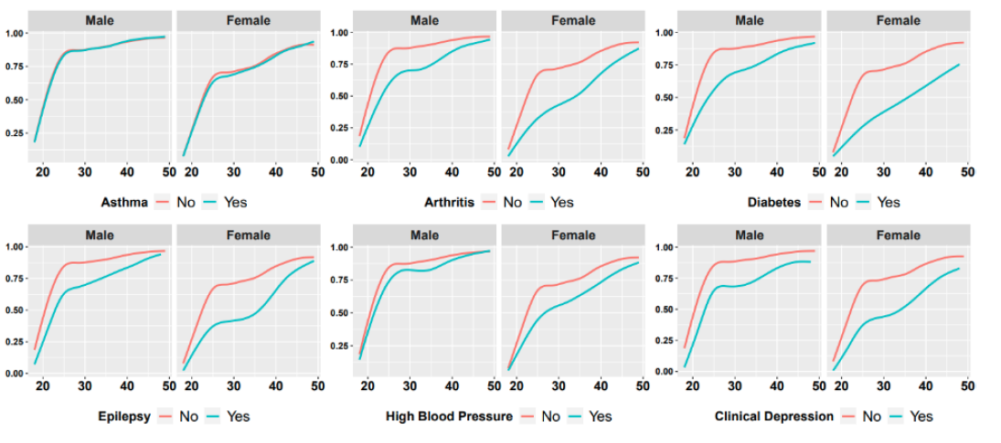
Results:
  Predicted probability of being employed by chronic disease, age and gender

Slide 10
Main findings:
  With the exception of asthma and diabetes, a diagnosis of each chronic disease was associated with substantially reduced likelihoods of living independently or with a partner, being educated to degree level, and of being in work
  When in work, these chronic diseases were associated with reduced earnings
  Living with some chronic diseases was also associated with greater loneliness and lower social support availability, but the magnitude of the difference in these measures was small.
Strengths/Limitations:
  The large dataset
  Lack of information data on disease severity, offline (vs. online) social interactions, quality/nature of social interactions
  Significant challenges in the statistical modelling of associations between our selected chronic diseases and social integration mean that causal relationships cannot be inferred
Conclusions:
  Our findings may have implications for the design and targeting of policy interventions
  The study also serves to describe the population we will use as a matched comparison group

Slide 11


Study 2. Summary
How does a cancer diagnosis affect education, employment, social, health and wellbeing outcomes? A matched case-control cohort study of TYAs in England
Questions
  RQ1: How does a cancer diagnosis affect economic and social outcomes during the transition to adulthood, compared to matched peers without cancer?
  RQ2: How does a cancer diagnosis affect health and wellbeing (i.e. mental health) compared to matched peers without cancer?
  RQ3: Does cancer severity influence economic, social, health, and wellbeing outcomes?
Methods
  Propensity score matching to compare participants with cancer (BRIGHTLIGHT) and without cancer (UKHLS) & regression models to evaluate the influence of cancer severity
  Compare outcomes at two timepoints: T1 @ 6-months post diagnosis & T2 @ 3-years post diagnosis
Datasets
  BRIGHTLIGHT – bespoke survey of 1,114 teenagers aged 13-24 diagnosed with cancer, between 2012 and 2014, from 97 NHS Trusts across England (Taylor et al., 2015) follow up in 5 waves across 3 years
  UKHLS (described in Study 1) – a nationally representative cohort survey

Slide 12


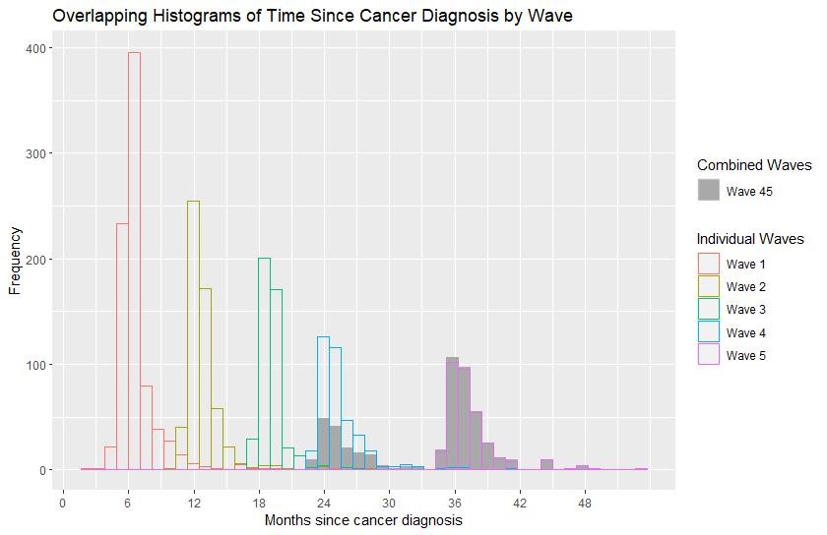
Text hierarchy and formatting with two images slide
BRIGHTLIGHT Cohort Data
BRIGHTLIGHT
COHORT
(
n
= 1,114
)
Deceased = 8
U
nwell = 16
Refusal = 200
Wave 1 (T1)
Other
= 60
Responses = 830
Deceased = 8
Wave 2
Drop out = 4
Responses = 566
D
eceased = 18
Drop out = 10
Wave 3
Responses = 460
D
eceased = 21
W
ave 4 (T2)
Drop out = 10
Responses = 394
D
eceased = 28
Wave 5 (T2)
Drop out = 16
Responses = 336
Our Sample:
T2 responses =
477
(Wave 5 = 336, Wave 4 = 141)
Analysis sample
=
445
(22 excluded as age 14
years
or younger at T1)

Slide 13
Text hierarchy and formatting with two images slide
Outcome Variables
Outcome | BRIGHTLIGHT | UKHLS
Main economic activity (employment, education, sick or disabled, not in employment or education or training (NEET) | QEMPLOY | _jbstat
Current level of study if in education (GCSE, A-level, degree level or equivalents) | QEDUCYR | _edtype
Living with parents (yes, no) | QHHCOMP | _livpar
Relationship status (single, cohabiting, or married) | QMARSTAT | _marstat
Health related quality of life (HRQoL) | EQ5D-3L | SF-12 mapped to EQ5D-3L
Mental health symptoms | Hospital anxiety and depression scale (HADS) | GHQ-12

Slide 14
Text hierarchy and formatting with two images slide
Control Variables
Variable | Levels | BRIGHTLIGHT | UKHLS
Age at T1 | Years | age_w1 | age_dv
Time between T1 & T2 | Days | Derived from interview dates | Derived from interview dates
Gender | Male/Female | gender | sex
Ethnicity | White British/ not white British | qethnic | ethn_dv
Highest Qualification ¹ | GCSE, A-level, Degree (or equivalents) | qeducqual | hiqual_dv
IMD quintile ¹ | 1 (least well off) to 5 | imd | imd_quintile
Long term health conditions ^{1, 2} | Yes/No | QLTI20(1, 2, 3, 6, 7, 8, 9, 11, 12, 13, 15) | Hcond (1, 2 , 3, 4, 5, 6, 7, 8, 11, 12, 14, 15, 16 ,17, 19 21, 22)
1: obtained at diagnosis for BRIGHTLIGHT and at first interview for UKHLS
2: Includes: infections, cardiovascular, pulmonary, kidney, liver, neurological and mental health conditions. Excludes: disabilities, visual and hearing problems.

Slide 15
Text hierarchy and formatting with two images slide
Matching
Characteristic | BRIGHTLIGHT, N = 401 | UKHLS, N = 765
Age at T1, years
Mean (SD) | 20.80 (2.77) | 20.78 (2.79)
min, max | 15.00, 25.00 | 15.00, 25.00
Time between T1 & T2, days
Mean (SD) | 828 (183) | 839 (219)
min, max | 367, 1,444 | 271, 1,251
Gender
Male | 225 (56%) | 430 (56%)
Female | 176 (44%) | 335 (44%)
Ethnicity
Not white British | 52 (13%) | 100 (13%)
White British | 349 (87%) | 665 (87%)
Characteristic | BRIGHTLIGHT, N = 401 | UKHLS, N = 765
Long term health condition ¹
No | 333 (83%) | 659 (86%)
Yes | 68 (17%) | 106 (14%)
Highest qualification ¹
None | 18 (4.5%) | 46 (6.0%)
GCSE or equivalent | 119 (30%) | 220 (29%)
A-level or equivalent | 170 (42%) | 305 (40%)
Degree | 94 (23%) | 194 (25%)
IMD quintile ¹
1 (most deprived) | 70 (17%) | 151 (20%)
2 | 67 (17%) | 138 (18%)
3 | 76 (19%) | 157 (21%)
4 | 96 (24%) | 157 (21%)
5 (least deprived) | 92 (23%) | 162 (21%)
1: Data obtained for BRIGHTLIGHT at date of cancer diagnosis, and for UKHLS at date of first interview

Slide 16
Text hierarchy and formatting with two images slide
RQ1: Economic Activity
Unadjusted frequencies
 | T1 |  |  | T2
 | BRIGHTLIGHT (N= 401) | UKHLS (N = 765) |  | BRIGHTLIGHT (N= 401) | UKHLS (N = 765)
Main economic activity
in education | 113 (28%) | 265 (35%) |  | 104 (27%) | 151 (20%)
in employment | 142 (36%) | 357 (47%) |  | 225 (57%) | 491 (64%)
sick or disabled | 46 (12%) | 7 (0.9%) |  | 31 (7.9%) | 12 (1.6%)
not employed, in education or training (NEET) | 99 (25%) | 136 (18%) |  | 32 (8.2%) | 110 (14%)
(Missing) | 1 | 0 |  | 9 | 1
Logistic regression: Sick/disabled or NEET = 1; not sick/disabled or NEET = 0
 |  | Coefficient (RR) | P-value | 95% confidence interval
T1 | Cancer diagnosis vs no diagnosis | 2.03 | <0.001 | 1.68, 2.47
T2 | Cancer diagnosis vs no diagnosis | 0.96 | 0.184 | 0.90, 1.02
Adjusted for age, time since first interview (last interview only), gender (male female), IMD quintile (5 categories), white British ethnicity (yes/no), highest qualification (none, GCSE, A-level, degree), long term health conditions (yes/no)

Slide 17
Text hierarchy and formatting with two images slide
RQ1: Economic Activity
BRIGHTLIGHT (Cancer Diagnosis)
UKHLS (Matched Controls)
T1
T2
T1
T2
Education
n = 113
57%
Education
n = 121
Education
n = 265
49%
Education
n = 173
38%
42%
Employment
n = 142
Employment
n = 167
Employment
n = 357
Employment
n = 347
5%
9%
Sick, disabled or NEET
n = 145
Sick, disabled or NEET
n = 71
Sick, disabled or NEET
n = 143
Sick, disabled or NEET
n = 99

Slide 18
Text hierarchy and formatting with two images slide
RQ1: Economic Activity
BRIGHTLIGHT (Cancer Diagnosis)
UKHLS (Matched Controls)
T1
T2
T1
T2
Education
n = 113
Education
n = 121
Education
n = 265
Education
n = 173
5%
5%
Employment
n = 142
88%
Employment
n = 167
Employment
n = 357
87%
Employment
n = 347
Sick, disabled or NEET
n = 145
7%
Sick, disabled or NEET
n = 71
Sick, disabled or NEET
n = 143
8%
Sick, disabled or NEET
n = 99

Slide 19
Text hierarchy and formatting with two images slide
RQ1: Economic Activity
BRIGHTLIGHT (Cancer Diagnosis)
UKHLS (Matched Controls)
T1
T2
T1
T2
Education
n = 113
Education
n = 121
Education
n = 265
Education
n = 173
Employment
n = 142
24%
Employment
n = 167
Employment
n = 357
Employment
n = 347
3%
44%
50%
Sick, disabled or NEET
n = 145
Sick, disabled or NEET
n = 71
Sick, disabled or NEET
n = 143
Sick, disabled or NEET
n = 99
32%
47%

Slide 20
Text hierarchy and formatting with two images slide
RQ1: Living with Parents
Unadjusted frequencies
 | T1 |  |  | T2
 | BRIGHTLIGHT (N= 401) | UKHLS (N = 765) |  | BRIGHTLIGHT (N= 401) | UKHLS (N = 765)
Lives with parents
No | 99 (25%) | 142 (19%) |  | 165 (42%) | 258 (34%)
Yes | 302 (75%) | 623 (81%) |  | 227 (58%) | 507 (66%)
(Missing) | 0 | 0 |  | 9 | 0
Logistic regression: Lives with parents = 1; does not live with parents = 0
 |  | Coefficient (RR) | P-value | 95% confidence interval
T1 | Cancer diagnosis vs no diagnosis | 0.90 | <0.001 | 0.85, 0.96
T2 | Cancer diagnosis vs no diagnosis | 0.85 | <0.001 | 0.77, 0.93
Adjusted for age, time since first interview (last interview only), gender (male female), IMD quintile (5 categories), white British ethnicity (yes/no), highest qualification (none, GCSE, A-level, degree), long term health conditions (yes/no)

Slide 21
Text hierarchy and formatting with two images slide
RQ1: Living with Parents
BRIGHTLIGHT (Cancer Diagnosis)
UKHLS (Matched Controls)
T1
T2
T1
T2
Does not live with parents
n = 95
84%
Does not live with parent
n = 165
Does not live with parents
n = 142
95%
Does not live with parent
n = 258
29%
16%
20%
Lives with parents
n = 297
Lives with parents
n = 227
Lives with parents
n = 623
5%
Lives with parents
n = 507
71%
80%

Slide 22
Text hierarchy and formatting with two images slide
RQ1: Relationship Status
Unadjusted frequencies
 | T1 |  |  | T2
 | BRIGHTLIGHT (N= 401) | UKHLS (N = 765) |  | BRIGHTLIGHT (N= 401) | UKHLS (N = 765)
Single
No (= married or cohabiting) | 54 (14%) | 123 (16%) |  | 81 (21%) | 187 (28%)
Yes (= not married or cohabiting) | 339 (86%) | 641 (84%) |  | 311 (79%) | 490 (72%)
(Missing) | 8 | 1 |  | 9 | 88
Logistic regression: Single = 1; Married/ cohabiting = 0
 |  | Coefficient (RR) | P-value | 95% confidence interval
T1 | Cancer diagnosis vs no diagnosis | 1.01 | 0.773 | 0.96, 1.05
T2 | Cancer diagnosis vs no diagnosis | 1.05 | 0.119 | 0.99, 1.11
Adjusted for age, time since first interview (last interview only), gender (male female), IMD quintile (5 categories), white British ethnicity (yes/no), highest qualification (none, GCSE, A-level, degree), long term health conditions (yes/no)

Slide 23
Text hierarchy and formatting with two images slide
RQ1: Relationship Status
BRIGHTLIGHT (Cancer Diagnosis)
UKHLS (Matched Controls)
T1
T2
T1
T2
Single
n = 331
88%
Single
n = 311
85%
Single
n = 562
Single
n = 490
23%
12%
15%
Married/ cohabiting
n = 53
Married/ cohabiting
n = 81
Married/ cohabiting
n = 115
10%
Married/ cohabiting
n = 187
77%
90%

Slide 24
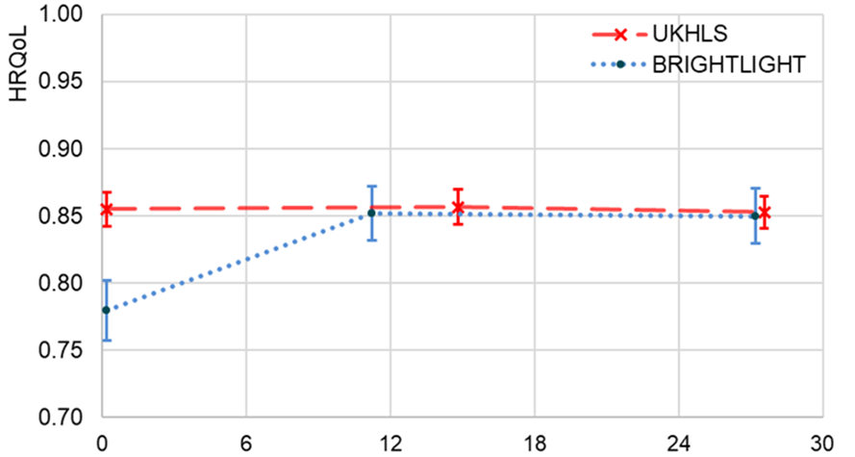
Text hierarchy and formatting with two images slide
RQ2: Health Related Quality of Life
HRQoL: Unadjusted mean values
HRQoL: OLS regression
Interview | Coefficient¹ | P-value | N
T1 | -0.073 | <0.001 *** | 1102
Mid point | -0.006 | 0.623 | 899
T2 | -0.007 | 0.548 | 1052
months
T1
Mid-point
T2

Slide 25
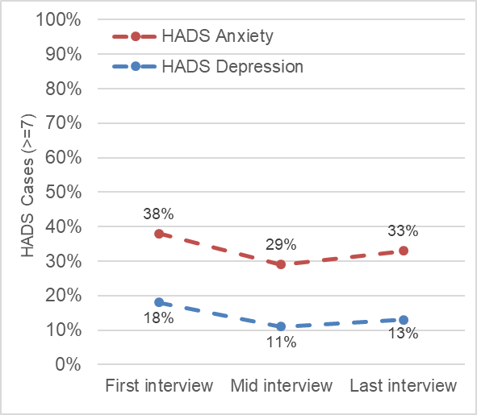
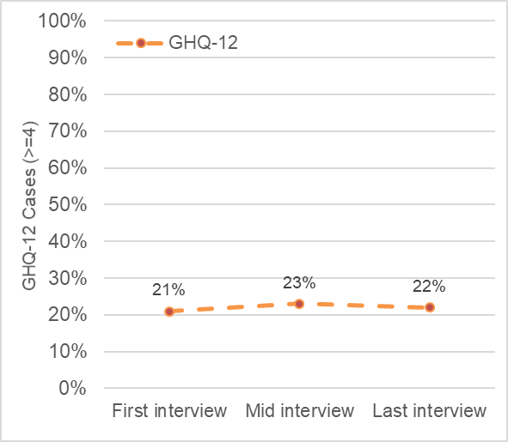
Text hierarchy and formatting with two images slide
RQ2: Mental Health
Mental Health Symptoms, unadjusted frequencies
BRIGHTLIGHT
UKHLS
T1
Mid-point
T2
T1
Mid-point
T2

Slide 26
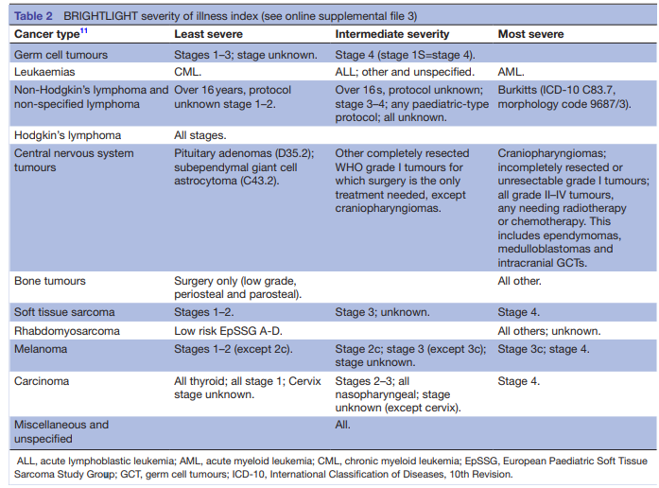
Text hierarchy and formatting with two images slide
RQ3: Methods
Does cancer severity influence key milestones/health and mental health?
Cancer severity – BRIGHTLIGHT severity of illness index
  This analysis compares least severe vs. intermediate + most severe
Regression model control variables
  Time since diagnosis (months)
  Time since first interview (months)
  Age (years)
  Ethnicity (white British/not white British)
  In lowest IMD quintile (yes/no)
  Long term health conditions (yes/no)
Table taken directly from Table 2 in Taylor et al. (2019)

Slide 27
Text hierarchy and formatting with two images slide
RQ3: Economics & Social Outcomes
RQ3: Impact of cancer severity
Intermediate and more severe cancers vs. less severe cancers
  More likely to be out of work or education at T1 and T2
  More likely to live in parents’ households at T1 and T2
  Less likely to be married or cohabiting at T1 and T2
  Transitions
    Less likely to enter employment by T2 if sick, disabled or NEET @ T1
    More likely to enter education by T2 if sick, disabled or NEET at T1

Slide 28
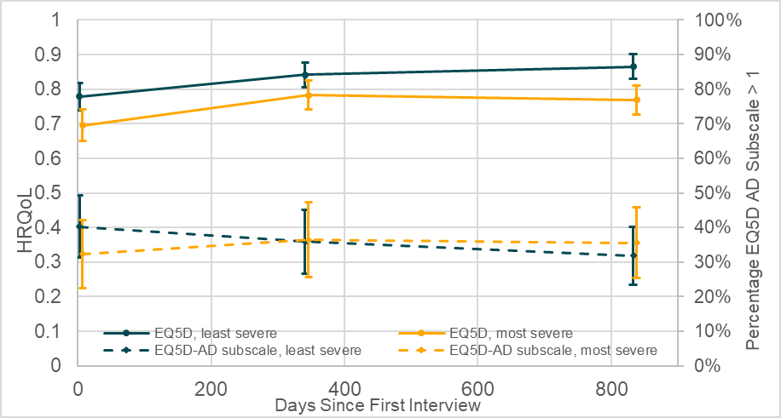
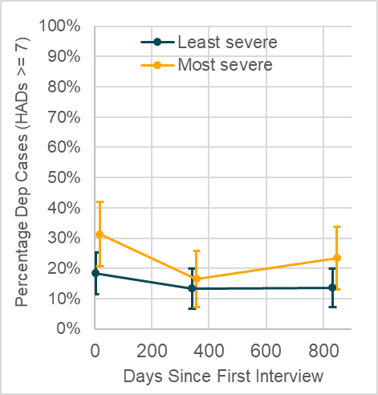
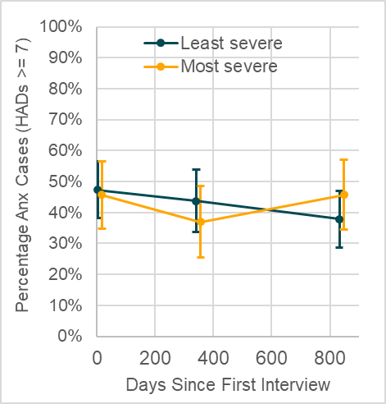
Text hierarchy and formatting with two images slide
RQ3: Health and Mental Health
Predicted values from three regressions at T1, mid point, and T2
OLS regression: HRQoL; logistic regression: EQ5D-AD subscale, HADS Depression, HADS Anxiety
Predicted values for: gender = male, mean age at diagnosis = 21, ethnicity = white British, in lowest IMD quintile = no, long term health condition = no,

Slide 29
How to display schools and/or Faculties in your slides
Study 2. Main findings
We utilise the BRIGHTLIGHT study, a large data set of young people with a cancer diagnosis, with high % follow up
Current studies often do not include a control group or utilise such good quality data
We find evidence of effects shortly after diagnosis (T1), which reduce by 36 months (T2) to:
  Economic activity (i.e., not being sick, disabled or out of work)
  Health
A cancer diagnosis was associated with:
  increased likelihood of ending a relationship
  increased frequency of being in education after being sick/disabled or NEET
The more severe cancer diagnoses were associated with increased impacts throughout for economic and health outcomes

Slide 30


Study 3. Summary
Aim
  To identify the level of disruption to wellbeing in young people living with and beyond a cancer diagnosis
  The factors that contribute to a poorer well-being/quality of life (QoL).
Questions
  What are the differences in wellbeing (QoL, mental health) across time, between young people with and without a cancer diagnosis?
  To what extent do social integration measures correlate with wellbeing?
  To what extent do pre-defined socio-demographic, clinical or psychological variables relate to worse social outcomes in young people with cancer?

Slide 31
Study 3 - Quantitative. Summary
Design
  A prospective longitudinal questionnaire study
    With a qualitative sub-study
    Across 2 purposively sampled cohorts of AYA across Yorkshire and London
  Considers immediate (up to 6 months post-diagnosis) and late effects (3-5 years post-treatment)
  Integrate and compare with BRIGHTLIGHT (historical/older patient dataset) and Understanding Society (comparator/counterfactual).
Participants
  Eligible if aged 16 to 39, diagnosed with any malignancy
  Cohort 1 recruited from 10 weeks to 6 months post-diagnosis
  Cohort 2 recruited @ 3 to 5 years post-treatment
  Data collected at consent and 6 months later
  Over 2 years we attempted to recruit between 264 and 528 participants.
  Recruited: Wave 1 = 301; Wave 2 = 201.

Slide 32
Study 3. Planned analyses
Quality of life
  Between group comparisons on markers of subjective wellbeing (physical, psychological, social well-being, and quality of life)
  Regression models to identify which of the social integration outcomes are associated with poorer QoL
Social well-being
  Between group comparisons on social integration outcomes (employment, education, social networks)
  Regression models to identify which socio-demographic, clinical, psychological factors correlate with poorer employment, education, and social networks.
Findings
  Data analyses in progress

Slide 33
Study 3. Preliminary results

Slide 34
Study 3. Preliminary results
52.2% some longstanding illness
15.3% Benefits

Slide 35
Study 3. Preliminary results

Slide 36
Study 3. Preliminary results

Slide 37
Study 3. Preliminary results

Slide 38
Study 3. Preliminary results
Cut-offs: Borderline 8-10; Case 11-21.

Slide 39
Study 3. Preliminary results
EQ5D
Mobility problems = 23.1%
Self-care problems = 13.4%
Usual activities problems = 42.5%
Pain/discomfort problems= 49.8%
Anxiety/depression= 66.7%

Slide 40
Study 3 – Qualitative. Summary
Aim
  Explore patients’ views of their disrupted biographies due to cancer (Bury, 1982), from diagnosis to post-treatment
  Use the cancer diagnosis as the ‘critical situation’ point of reference
  Allow for the emergence of factors explaining SI
  Initial and ‘re-invented’ biographies, ongoing or re-defined expectations, perceived factors hindering or promoting SI
Questions:
  How are social integration outcomes (i.e. work, education, relationships) disrupted for young people from pre-Dx to post-treatment?
  What type of support was available for them during their diagnosis and treatment?
  What could be done to better support them, both at the stage of cancer diagnosis, throughout their treatment, and after their treatment has ended?

Slide 41
Study 3 – Qualitative. Summary
Method:
  Semi-structured interviews with 43 purposively sampled participants
  Interviews conducted, transcribed and coded by 5 researchers with sociology and psychology backgrounds
Analysis:
  Framework analysis – a subtype of thematic analysis
  Summary of results ongoing

Slide 42
The journey from pre-cancer diagnosis to the present = on key topics (education, work relationships) plus any emergent topics chosen by the participant (i.e. key events, meeting a support group, changes in family life like moving out etc)
The diagnosis
During treatment
After treatment
You before
You now
Topics to be discussed with researcher:
Important moments
Education
Work
Relationships
Other things that are important to you
Timeline

Slide 43
Participants
Cohort 1 (N=21) |  | Cohort 2 (N=22)
Location |  | Location |  | Total
London | 7 | London | 11 | London = 18
Leeds | 14 | Leeds | 11 | Leeds = 25
Age
16-24 | 7 | 16-24 | 4 | 16-24 = 11
25 -39 | 14 | 25-39 | 18 | 25-39 = 32
Diagnoses
Bowl | 0 | Bowl | 1 | Bowl = 1
Brain | 2 | Brain | 1 | Brain = 3
Breast | 4 | Breast | 2 | Breast = 6
Carcinoma | 0 | Carcinoma | 1 | Carcinoma = 1
Germ cell | 2 | Germ cell | 4 | Germ cell = 6
Gynae | 0 | Gynae | 1 | Gynae = 1
Leukaemia | 2 | Leukaemia | 3 | Leukaemia = 5
Lymphoma | 3 | Lymphoma | 2 | Lymphoma = 5
Sarcoma | 5 | Sarcoma | 3 | Sarcoma = 8
Thyroid Cancer | 2 | Thyroid Cancer | 0 | Thyroid = 2

Slide 44
Framework 1 – Disruption and Support
Framework 2 – Impacts and reflections
Education: awareness, change, disclosure, disruption, flexibility, pressure, return, routine, support
Physical: adjustment, body image, cognition, fatigue, recovery, side-effects, relapse
Employment: awareness, change, disclosure, disruption, finance, flexibility, pressure, return, routine, support
Emotional: acceptance, anger, anxiety, autonomy, avoidance, guilt, humour, identity, low mood, overwhelmed, resilience
Social life: boredom, comparison, disclosure, disruption, isolation, normality, online, presence, return, routine, support
Fertility: communication, gender/sex, impact, satisfaction, sexuality, urgency
Relationships: cancer peers, colleagues, dating, family, friendship, partner, parenting, parents, siblings
Reflections: future plans, hope, others, perspective, self, uncertainty
Hospital life: age-appropriate care, charity, comfort, confidence, consistency, health literacy, isolation, mental health support, resources, system navigation, timing/offers of support
Improvements: age-appropriate care, awareness, mentoring, mental health support, systems, timing, wider support
Staff: CNS, consultant, GP, nurse, psychologist, YSC, social worker
End of treatment: closure, communication, continuity, gratitude, pressure, support, fear

Slide 45
Study 3 – A few quotes
Pressure:
  Education:
… I had the intensive part of the treatment [for] about 8 months and I finished in the August and I'm I think my, like, my CONSULTANT he sort of said - you know, ideally shouldn't go back to university straight away because you're not as fit and healthy as we would want you to be. But obviously 'cause of the term dates there wasn't choice. So I didn't - I probably only went to about 50% of lectures and Uhm, seminars. Just because I didn't feel great all the time and also, I think there was an element… I wanted to go out and actually have some fun. So I'd sort of go out and then I'd realize that: Oh, actually, it would then wipe me out for about a day, and then I wouldn't go to lectures. Which…Yeah It wasn't right. (…) Yeah, that was difficult. Ideally, I'd like to have had maybe another couple of months at home to sort of rest up. And I did have a couple of hospital admissions during my first semester just because I've got infections and I obviously couldn't fight them. So I was in hospital then …(F, 25+, Leukaemia, London).
  Employment:
I think actually the surgery, uhm (…) it was a combo of all three, made me not as good – well, according to them, I was slower at doing things, I was making mistakes. And that is when I was put onto a disciplinary with a verbal warning, because my work wasn’t strong enough. I wasn’t good enough. (…) I asked if I could work in Leeds two days a week, and work from home three. And they refused that. They said I could go down to part time and work two days, and work from home for half a day. Which I did. But that was wearing me out. I’d be getting a 5 o’clock train (…) I think there were parts that made me realise that they weren’t looking out for me as much as I thought they would be. I had a bit of a breakdown in my manager’s office and I said that being in for two days was too much for me, to travel that far and then come back and work just for half a day. And next thing, she disappears, speaks to HR and says okay, you just have to work one day in the office and you can work from home a day and a half. And part of me was thinking: why did I need to have a breakdown in front of my boss for that to happen, rather than them actually trying to help with what was going on (F, 25+, Brain, Leeds).

Slide 46
Normality
there was some events I couldn't make. The ones that I did, I tried to have a normal life and I did try to still have that aspect of my social life and first year especially 'cause it is my first year at university and I wanted to still have that experience even though I lost all my hair and you know, looking back at the photos I you can tell I was sick, but at the time you- my friends, I think got used to it. Seeing me without eyebrows and without hair. And it just looked normal, I guess looking back, you can really tell and I think I just wanted to make sure I still had that first year experience and still try to enjoy it as much as I could (M, 16-24, Sarcoma, London).
Uhm yeah. So I mean, some of that pressure came from me. I was really like, you know, I just want to get back to normal as quickly as possible. And I kind of really pushed myself into it. And I feel like I over pushed myself a little bit too hard. And some of this was also there: ‘Oh, you're done with cancer now. You've had the all clear…’ – [People] just not realizing the long term impact that that it can have on you (F, 25+, Lymphoma, London).
Changing motivations
So I then went back and started my first year the next September I actually did a different course though, so that was one positive because I'd done a module in accounting and finance with the two months I'd been there and I really enjoyed that surprisingly so I then changed from business management to accounting and finance which is now what I'm in… I wouldn't have changed degrees, had it not been for my diagnosis (F, 25+, Leukaemia, London).

Slide 47
Online challenges
You know there can be some dark thoughts where you're saying ‘look what everyone else is doing’. That's why I don't go on social media, because I would be in an awful, awful, awful state of mind if I were to go on social media throughout this period, particularly Instagram (M, 25+, Brain, London).
Family (guilt)
I'm the patient; I genuinely think that it affected those around me as much as it did me, or potentially even more. We watched… Deadpool came out the same time, and that's about somebody getting cancer. And granted, it's a stupid comedy superhero movie. But it did say, you know, there's a line in it that said, cancer is not horrendous because of how much it affects you. It's horrendous because of how much it affects your friends and family. And I agree that that is the worst thing about it. I did need support. But I have just gotten through it. And when I was done with it, I was done with it. Whereas my friends and family, that is a worst thing that they might have to live on (.) without me and worrying about the guilt of… did they do enough and things like that. Whereas for me, if I die? Yeah, that's scary. It's not what I want, but I'm gone. I don't have to deal with that (M, 25+, germ cell, Leeds).
Oh gosh, it felt really… It was really horrible. It felt like I had such a strong sense of shame and guilt, like I felt like we were this relatively young couple and I just brought this really uninvited horrible, you know, kind of uninvited guest into our home and that, you know, neither of us really wanted or had planned for. And I felt as well, like, 'cause, I've always been fairly, like feminist and been, like, things need to be done 50/50 in terms of housework and then suddenly it was like if I could do, like any housework that was great, you know? So it's such a profound sense of guilt and shame over the impact it had on our lives (F, 25+, Lymphoma, London).
Friends (understanding)
one of my closest closest friend, my best friend in the world, who I lived with when I was in treatment I would say our actual relationship (…) there was a massive disconnect because I think she came to visit me once and I think she wasn't quite expecting the gravity of it all and how just how unwell I was. So I think it just was a complete shock to the system and I just remember thinking she's not someone I can message all the time now. And so I remember not having much contact with her while I was in, because she couldn't cope and I couldn't cope with her not coping yeah. So that there was a lot of relationship changes for sure (F, 16-24, Lymphoma, Leeds).

Slide 48
Support to return
  Education:
… my course leaders were fantastic. They were all brilliant and I think in a weird way, I mean, they'd all had cancer or, like, had their partner had cancer. So when I explained it to them, they were all like your fine like, don't you worry we've got you, which definitely worked in my favour because that you know, if there were days where I was so tired I couldn't get out of bed and I had a lecture at 10 I didn't get penalized, which in some ways I was like this is probably bit unfair, but then I guess I I had special considerations, but they were so good about making sure that someone sent me the notes or the session was recorded. They just they were, I can't even begin to say how supportive they were with making sure that I didn't feel like my physical side effects were putting me at disadvantage. (F, 16-24, Lymphoma, Leeds)
  Employment
my work (...) were very supportive (...) surprisingly, I was on a zero hour contract at work and people obviously wanted to keep me so my superiors, they gave me a contract so they could pay me sick leave until I got better and came back. (…) people had to fundraise for me, because they understood I was on a pretty low salary during this zero hour contract. So we've organised a fundraiser. And I've been told later when I got back to work, that never happened before (M, 25+, Lymphoma, Leeds)

Slide 49
STARS Study: Summary
In short:
  Less employment and income
    Gendered: especially in women
  Delays in completing education
    More people embrace education following cancer
  More relationship breakdown
  More move back into the parental home
    Although fewer end up living with their parents
  Poorer mental health: higher levels of depression and anxiety
  Patients declare wanting changes focusing on:
    Awareness of the disruptive effect of cancer in work and education
    Better knowledge of disruptions in the general population
    Greater flexibility from institutions and peers
    Additional support in terms of:
      Mental health to help deal with: change, disruptions, pressures
      More resources incl. peer & social welfare support on adult wards

Slide 50
Final output - Integration within existing clinical, social and psychological NHS policy & practice
Question: How do we integrate the findings from these 3 studies within a Multidimensional Stratification Model of Social Integration Outcomes for the NHS to help reduce inequalities in outcomes and service provision?
Method:
Integrate quantitative and qualitative findings
Link them to policy and services (espc. missing MH support)
Involve patients, charities, and healthcare professionals with knowledge of policy and service delivery to link findings to practice
Outcome:
Policy proposals to implement model within NHS cancer services

Slide 51


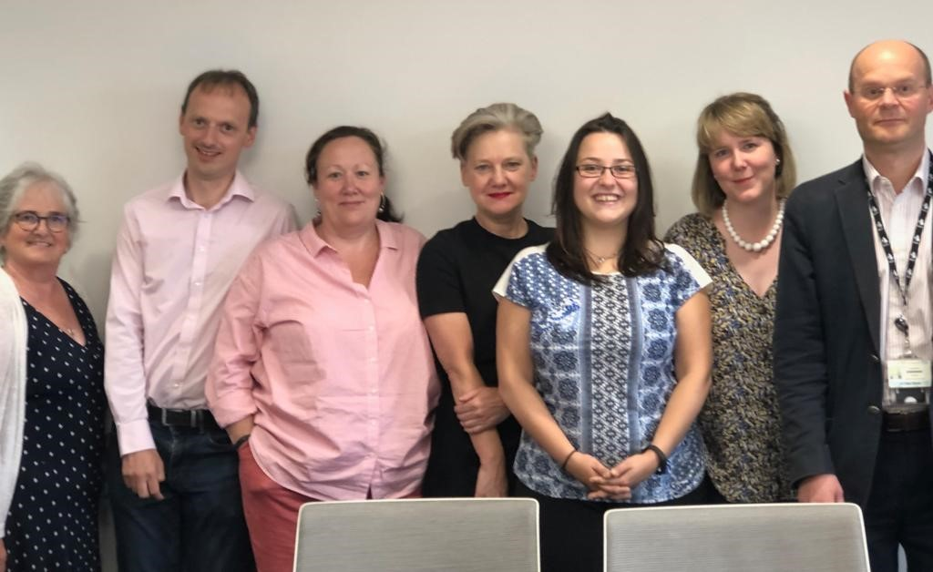
Thank you for listening
Questions? Suggestions?
Contact: d.p.stark@leeds.ac.uk; a.martin1@leeds.ac.uk; o.c.lindner@leeds.ac.uk

Slide 52
Acknowledgements
Economic and Social Research Council
TYA, Breast, Brain, Haematology, Paediatric, Thyroid, Lung, Gynaecology, Colorectal, GI, Germ cell, Urology, Head & Neck, Melanoma teams
Young Advisory Group
Academic Advisory Group
Former team members: Rizwana Uddin, Joanne McCulloch, Luke Hughes
PCOR team, especially Zoe Rogers and Christopher Bedding. Also Rob Carter, Jeremy Dwyer, Sarah Dickinson, Andrea Gibson.

